Slide 1
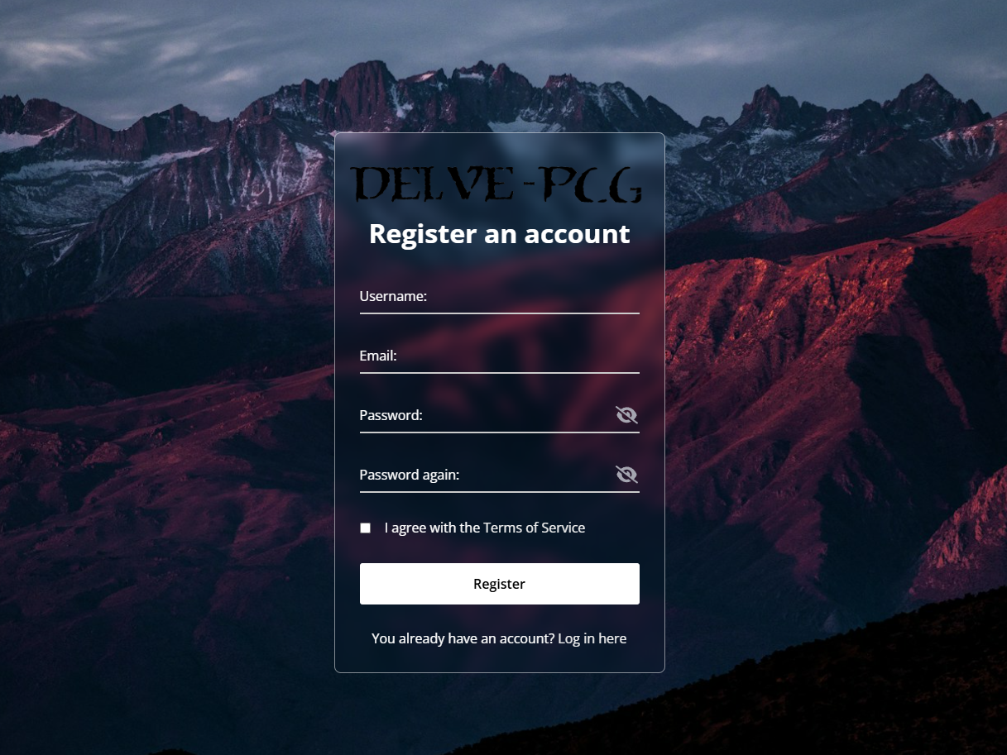
Registration page
It is available on these sites
You can
here
Simple input fields
Option to make your password visible and to hide again
In case you already have an account

Slide 2
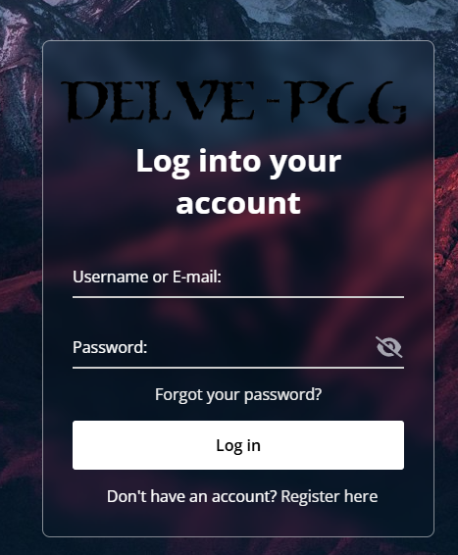


Login & Password reset page
It is available on this site
You can
here
Simple input fields
Option to make your password visible and to hide again
In case you don’t have an account
In case you forgot your password, worry non!

Slide 3
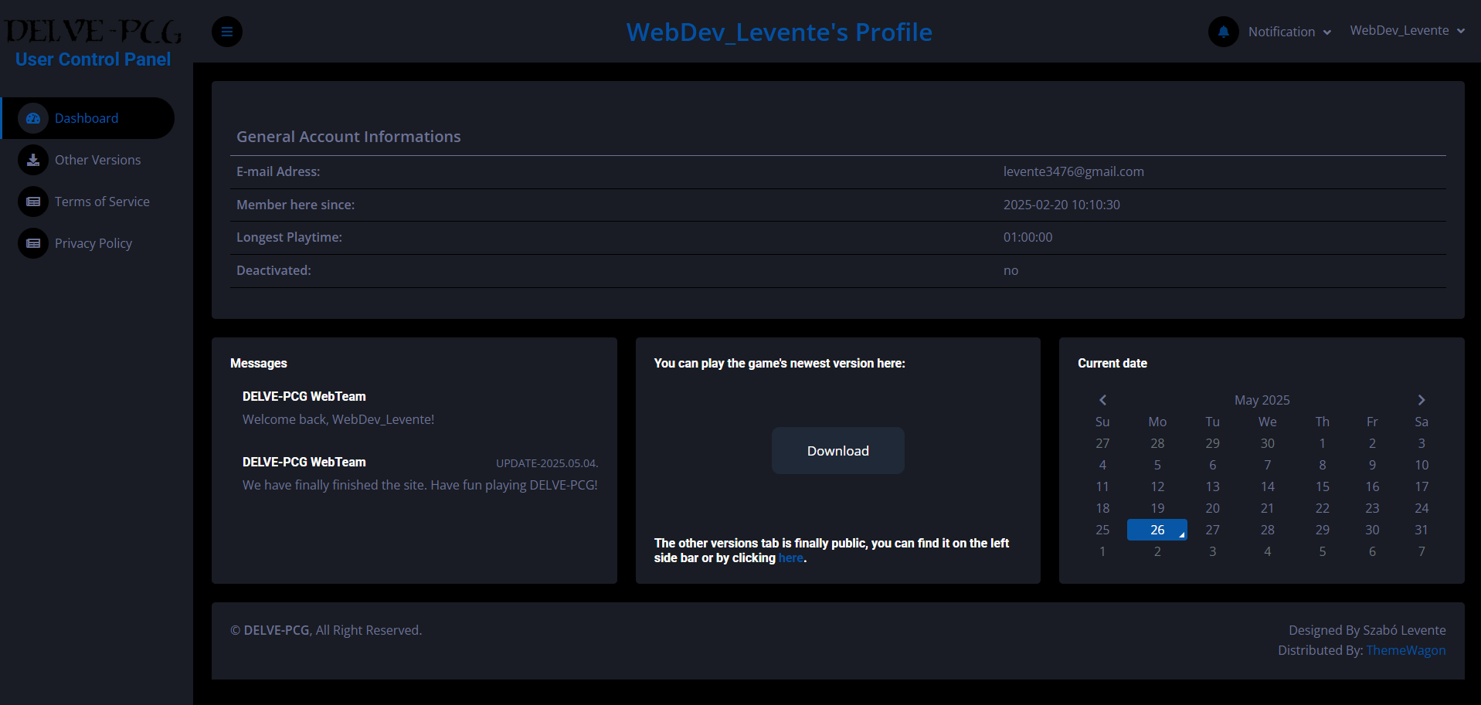
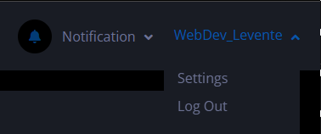

User Control Panel (UCP)
I am going to talk about this in the next slide
It is available on this site
Available after successful login
You can see some General Account Information
Download the latest version of the game
Check older versions of the game
As well as having the ability to read the Terms of Service and Privacy Policy in case there has been changes

Slide 4
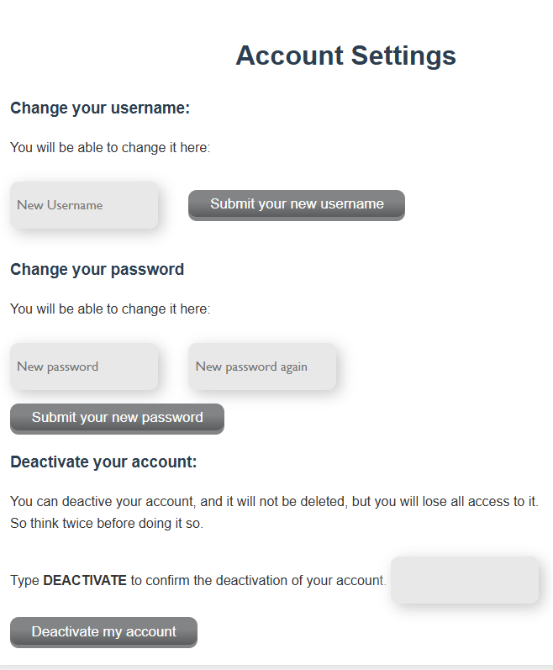
Account Settings
It is available on this site
Username changing option
Password changing option
(Proceed with Caution) Account Deactivation option

